Slide 1
Practice Problems (Discrete R.V)

Slide 2
Problem 1
A fair 6-sided die is rolled repeatedly until a 6 is obtained. Find the
expected number of rolls conditioned on the event that none of the
rolls yielded an odd number.

Slide 3
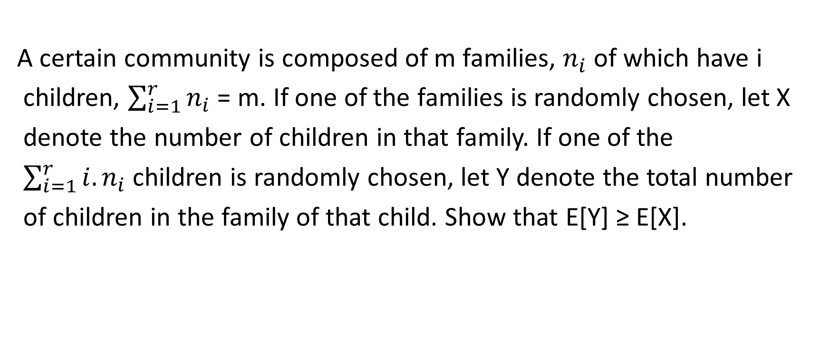
Problem 2
A certain community is composed of m families, $n_{i}$ of which have i
children, $\sum_{i=1}^{r}{n_{i}}$ = m. If one of the families is randomly chosen, let X
denote the number of children in that family. If one of the
$\sum_{i=1}^{r}{{i.n}_{i}}$children is randomly chosen, let Y denote the total number
of children in the family of that child. Show that E[Y] ≥ E[X].

Slide 4
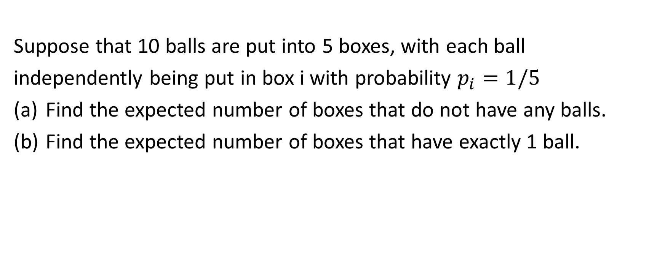
Problem 3
Suppose that 10 balls are put into 5 boxes, with each ball
independently being put in box i with probability $p_{i}=1/5$
Find the expected number of boxes that do not have any balls.
Find the expected number of boxes that have exactly 1 ball.

Slide 5
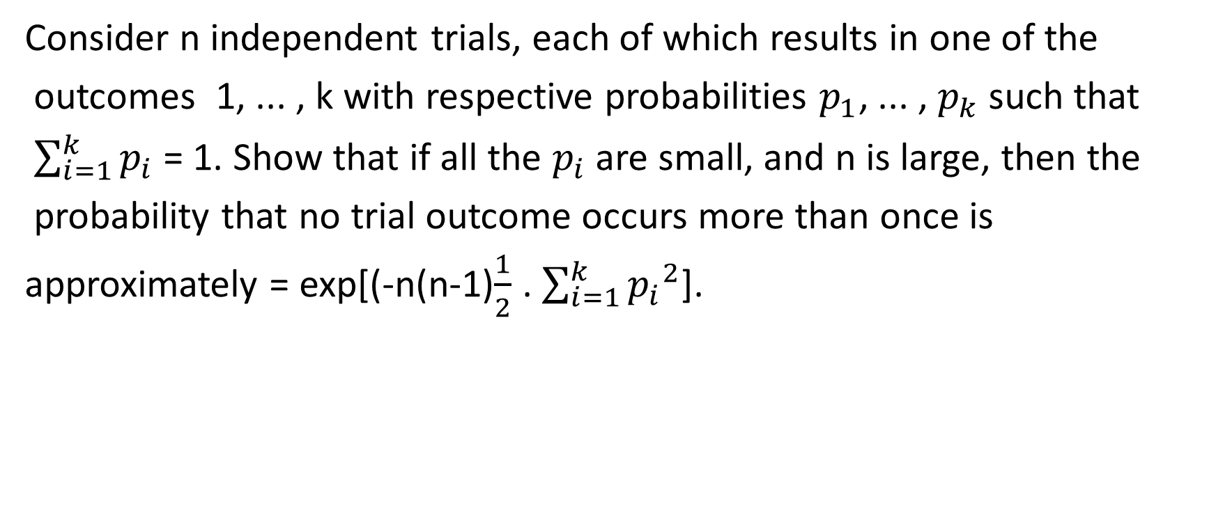
Problem 4
Consider n independent trials, each of which results in one of the
outcomes 1, ... , k with respective probabilities $p_{1}$, ... , $p_{k}$such that
$\sum_{i=1}^{k}{p_{i}}$ = 1. Show that if all the $p_{i}$ are small, and n is large, then the
probability that no trial outcome occurs more than once is
approximately = exp[(-n(n-1)$\frac{1}{2}$ . $\sum_{i=1}^{k}{{p_{i}}^{2}}$].

